Slide 1
Zen Music Festival
Responsive Design

Slide 2
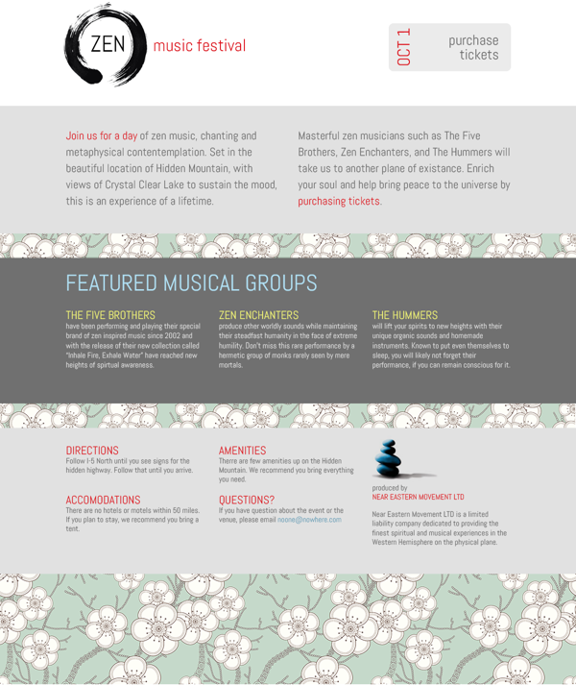
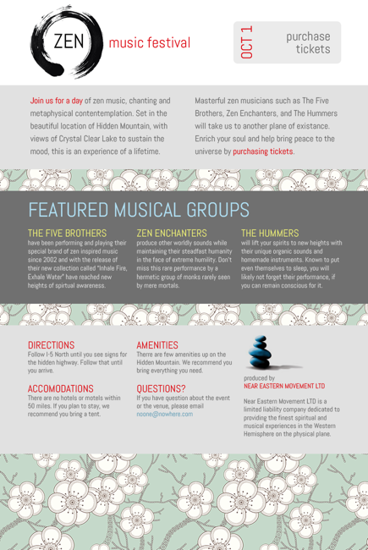
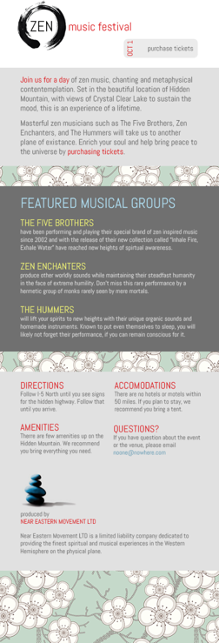
960 pixels
768 pixels
I have a design for this Zen music festival which will suit us for our first responsive design. Let’s get some basic page structure in place first.
480 pixels
320 pixels

Slide 3
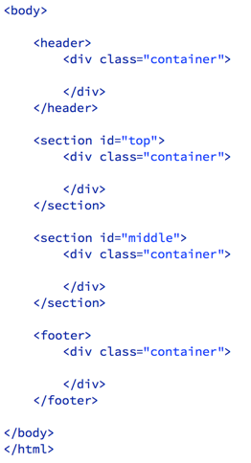
We will be using this google font, Abel. Let’s put the link to the font in the head of the file.
This HTML will describe the basic structure for the page. Each section of the page goes all the way across the window, but there is an internal div with the class of container that we will use to constrain the width of the content.
For now it will be fixed width, but soon it will be responsive.

Slide 4
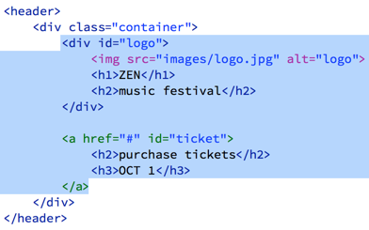
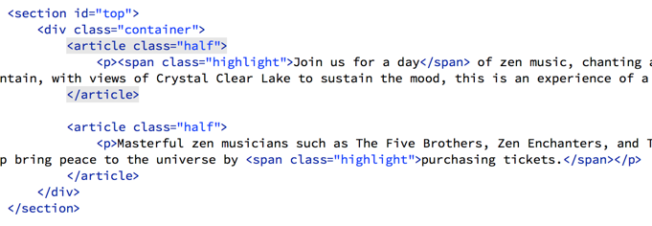
In the header, I added a div for the logo which includes the image and an h1 and h2.
The ticket on the right side is going to be a link, so I made it an anchor tag. It seems a little weird to put block level elements inside an inline element, but this is legal in HTML5.
We will be setting this anchor tag to display as a block element anyway, and it is a good way to make the whole thing clickable.
The top section gets two articles with the class of half, because they will make up the two columns. I put these on snippets, so you don’t have to type them.

Slide 5
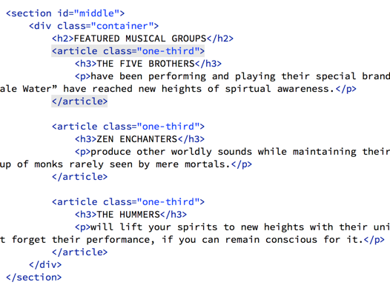
This markup is pretty easy and straightforward for the middle section. There is the H2, then the articles are split into thirds.

Slide 6
The footer is a bit more complicated.
We have the footer element with the container inside it. Inside that we have a two-thirds div and a one-third div.
Inside the two thirds div, there are two rows. Inside the rows, I have one half width articles. If we get the padding right on everything, it should just work. I put the HTML on the snippets. Once you have that in place, all the HTML we need is there. We will just need some styling.

Slide 7
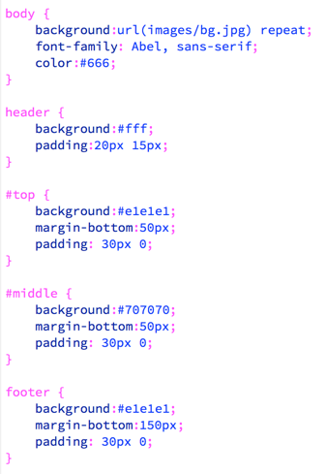
Before I get into styling all the elements, I am going to add this rule to the css reset, as it resets the way the box model works for all elements.
These rules will get a lot of the structure we need for the page in place quickly. We are setting the font, and the background color of each element on the page, as well as setting some basic padding and margins on these elements.
Note the flower pattern is the background image for the whole page.

Slide 8
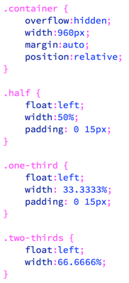
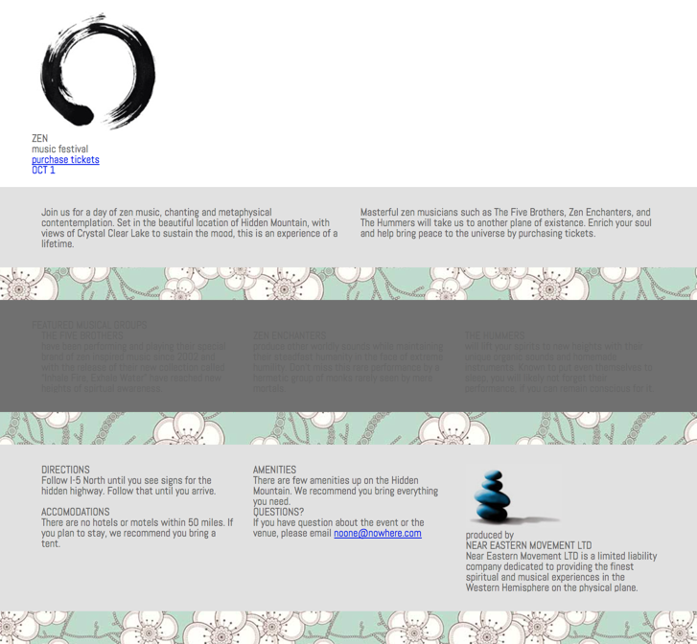
These rules will set up the basic grid for the page. With these in place, the layout of the page is coming together. Notice I put position relative on the container, this is because I will do some absolute positioning of elements in the header.

Slide 9
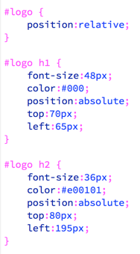
These rules will get the logo elements to position correctly. I simply used trial and error to get the top and left positions correct.

Slide 10
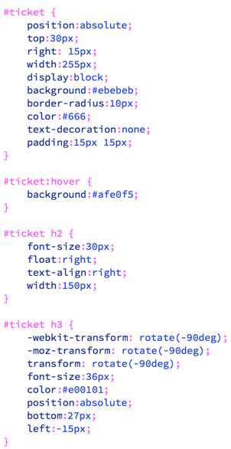
These rules are for positioning and styling the ticket elements. It takes a bit of effort to get it all in place. I put them on the snippets, so you don’t have to type them all.
With those styles in place, the header is looking pretty good.

Slide 11
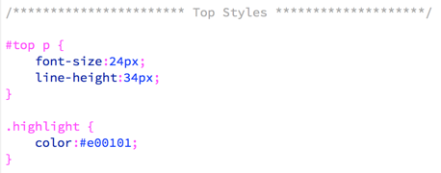
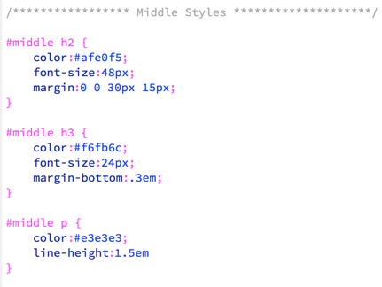
The top section only needs these two little rules to get it looking right.
The middle section doesn’t need much either.

Slide 12
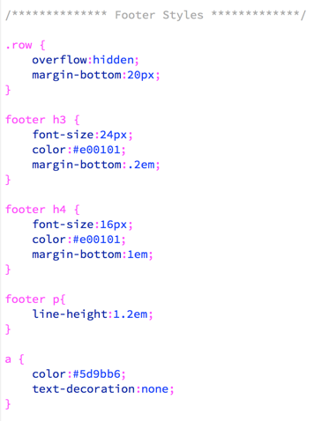
A few simple rules to style the type in the footer gets everything else in place. The row class is set to overflow hidden because the articles inside it float left.

Slide 13
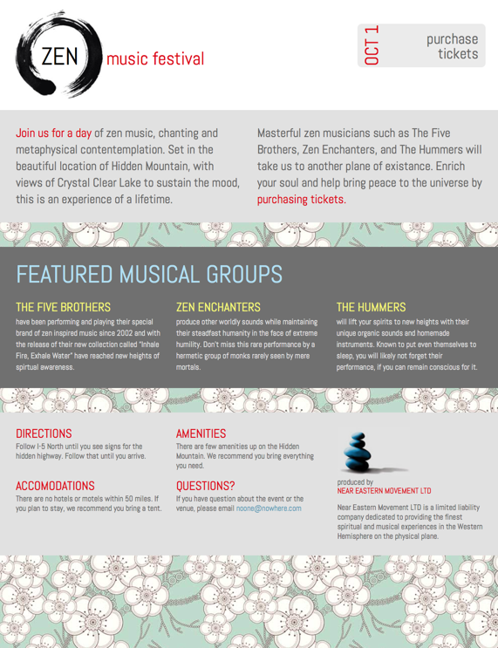
Looking pretty good…
Our basic layout is in place. Next we will make it responsive.

Slide 14
Before we start adding rules to the CSS. Be sure to add this to the head of the html file for it to actually work on mobile devices.
Then, if you add this media query at the bottom of the page, the page will be mostly responsive at sizes less than 960px. Since we set the other layout elements in percentages, rather than pixels, they squish down as the page gets narrower. We just need to fix elements when they break or deviate from our design comp.

Slide 15
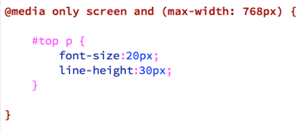
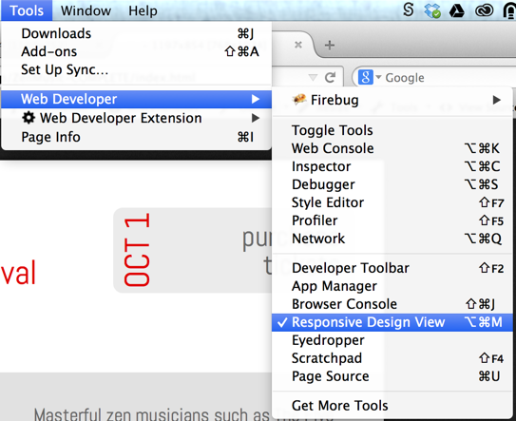
The only thing that needs to change for the 768px wide version is the type in the top section.
If you are using Firefox, you can go to Tools > Web Developer > Responsive Design View to get a good idea of how it looks a common sizes.
I set it to 768 x 1024.
There is also a great web developer extension with more tools available that I frequently find useful.

Slide 16
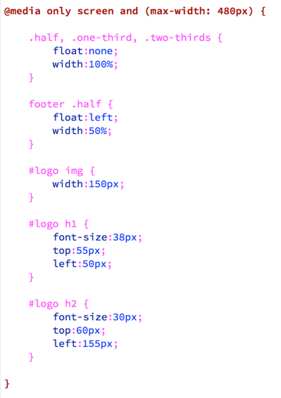
When we get down to 480px wide, we will need to make a lot of changes. When I have to do this part, I find it easiest to copy the rules from above that I am adjusting in this section.
I remove the declarations from the copies that are not changing at all, then adjust the ones that are changing.
In this layout, I am moving to a mostly one column layout, so I remove the floats from my layout classes and set their width to 100%.
The only exception is the .half class in the footer. I still want two columns. The footer .half rule will make that happen.

Slide 17
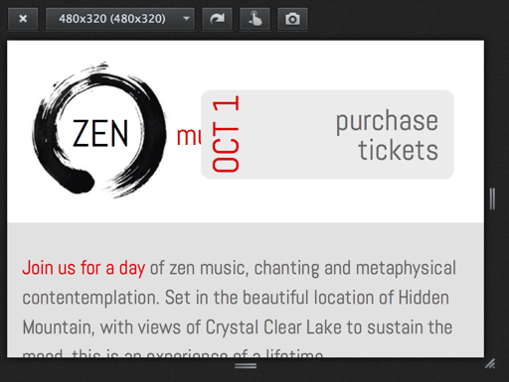
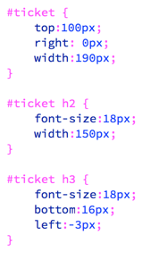
The logo is in place for this view, but the ticket needs some work. The styles below should get it in place. Be sure to put them inside the media query for 480 pixels wide.

Slide 18
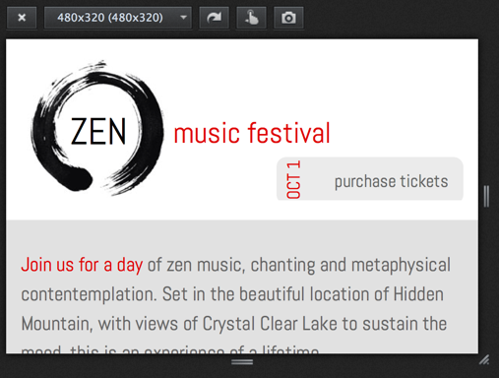
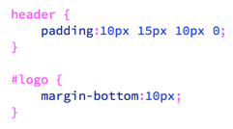
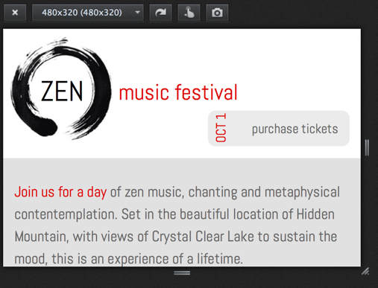
It is mostly working. However, the bottom of my ticket is getting cut off. This is because the element is pushing out of the .container element, which has overflow:hidden set. It is infact hiding the part of the ticket that is sticking out.
A few minor adjustments will fix it.
By adjusting the padding on the header and putting some margin on the bottom of the image in the logo, we can push the container down a bit. I could also just set a min-height.

Slide 19
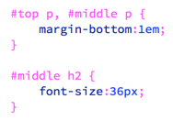
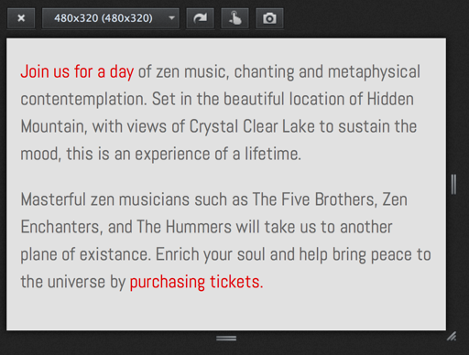
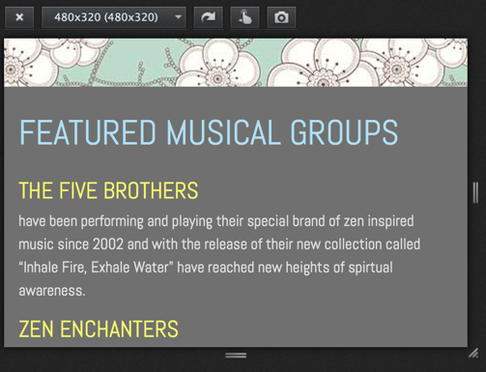
We just need two more rules to adjust the typography a bit for this media query and the hardest one is then done.

Slide 20
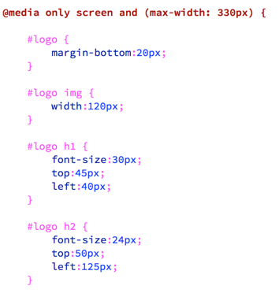
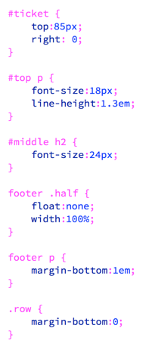
Things start to break down again once we get to about 330 pixels wide, so we need to adjust everything again.
Also, for this view, we are going to single column entirely. So I have to remove the float on the .half class elements in the footer.

Slide 21
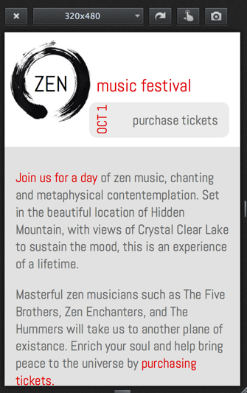
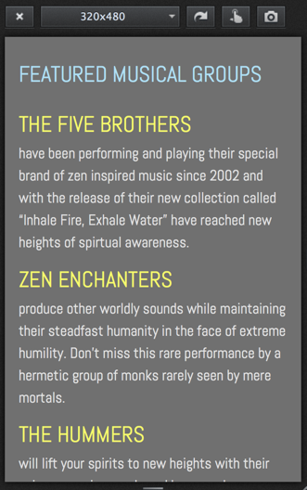
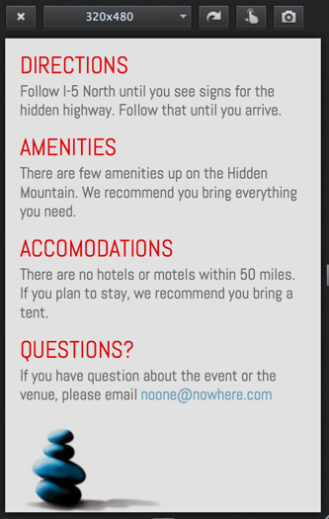
This is looking pretty good, all the way down the page.

Slide 22
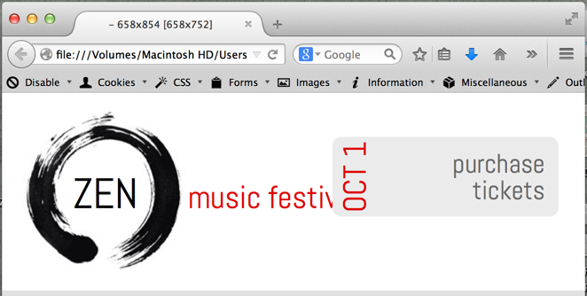
One final check while scaling the window down reveals that there is a problem with the ticket at sizes less than 700 pixels down to the next media query at 480 pixels. I can fix this with one more media query.
By the way, I got the size of the window in the name of the tab by using the Web Developer plugin. Go to Tools > Web Developer Extension > Resize > Display Window Size In Title. Very useful!

Slide 23
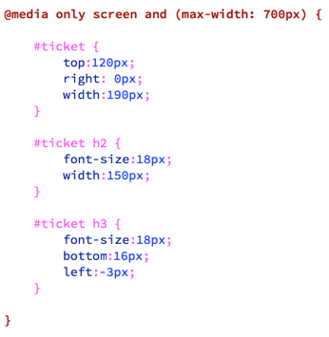
I will make one more media query for 700 pixels wide. Put it after the 768 pixel wide media query and before the 480 pixel wide media query.
I cut the rules for the #ticket element from the 480 pixel wide media query and put them in here instead.
Then I adjusted the top declaration for the #ticket element.
In the 480 pixel wide media query, I just need to set the top declaration back to 100px.
That should be just about it. The page should look pretty good at all sizes.

